Slide 1
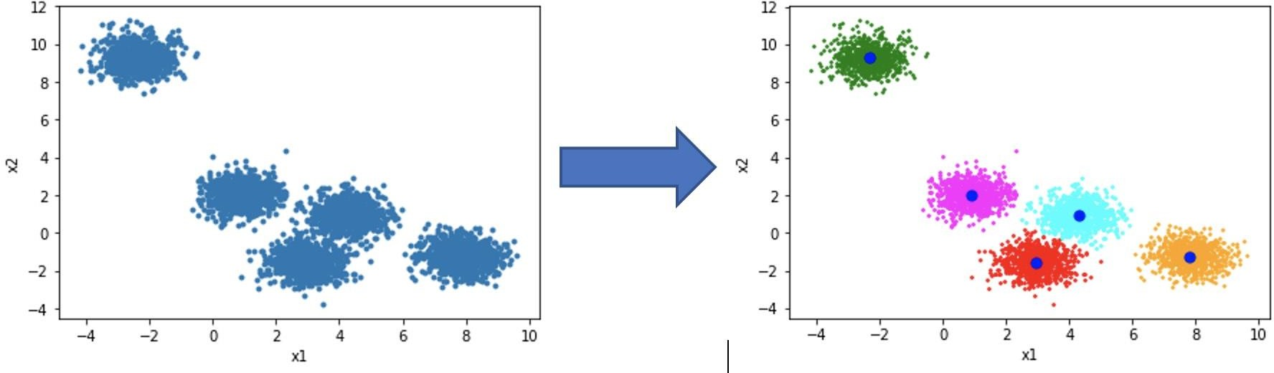
Unsupervised Learning: Clustering
Clustering is the task of dividing the population or data points into a number of groups such that data points in the same groups are more similar to other data points in the same group and dissimilar to the data points in other groups.
Before
After
After Cluster
Cluster
Abu Bakar Siddique Mahi

Slide 2
Applications of Clustering: Real-World Scenarios
Clustering is a widely used technique in the industry. It is actually being used in almost every domain, ranging from banking to recommendation engines, document clustering to image segmentation.
Customer Segmentation
Document Clustering
Image Segmentation
Recommendation Engines

Slide 3
Perform K-Means Cluster
Tasks:
The k-means cluster algorithm mainly performs two important tasks:
Determines the best value for K center points or centroids by an iterative process.
Assigns each data point to its closest k-center (also called centroid). Those data points which are near to the particular k-center, create a cluster.
Javapoint.com

Slide 4
The working of the K-Means algorithm is explained in the below steps:
Step-1: Select the number K to decide the number of clusters.
Step-2: Select random K points or centroids.
Step-3: Assign each data point to their closest centroid, which will form the predefined K clusters.
Step-4: Calculate the variance and place a new centroid of each cluster.
Step-5: Repeat the third steps, which means reassign each data point to the new closest centroid of each cluster.
Step-6: If any reassignment occurs, then go to step-4 else go to FINISH.
Step-7: The model is ready.
Javapoint.com

Slide 5
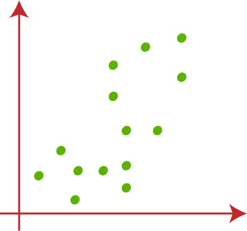
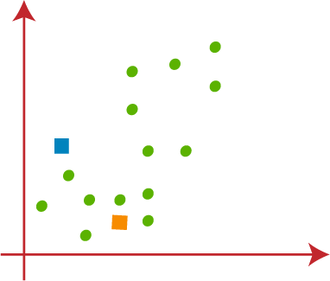
Perform K-Means Cluster
Assume, we have two variables M1 and M2. The X & Y axis scatter plot of these 2 variables is given below:
1st step ->
Note: We need to choose some random k points or centroid to form the cluster. These points can be either the points from the dataset or any other point.
Javapoint.com

Slide 6
Perform K-Means Cluster
1st Data Point
Step -> 3
Javapoint.com

Slide 7


Perform K-Means Cluster
Javapoint.com

Slide 8
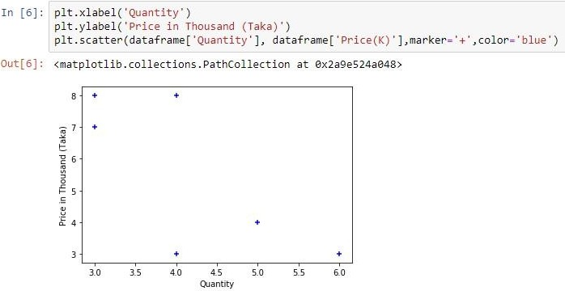
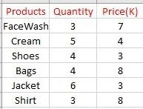
Let’s see an EXAMPLE

Slide 9
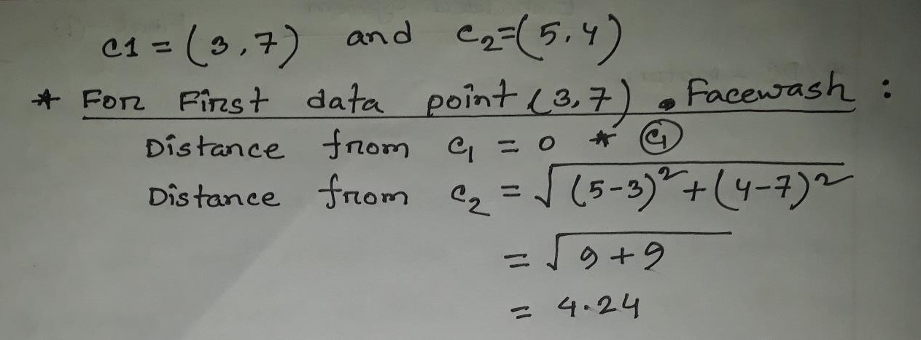

Slide 10
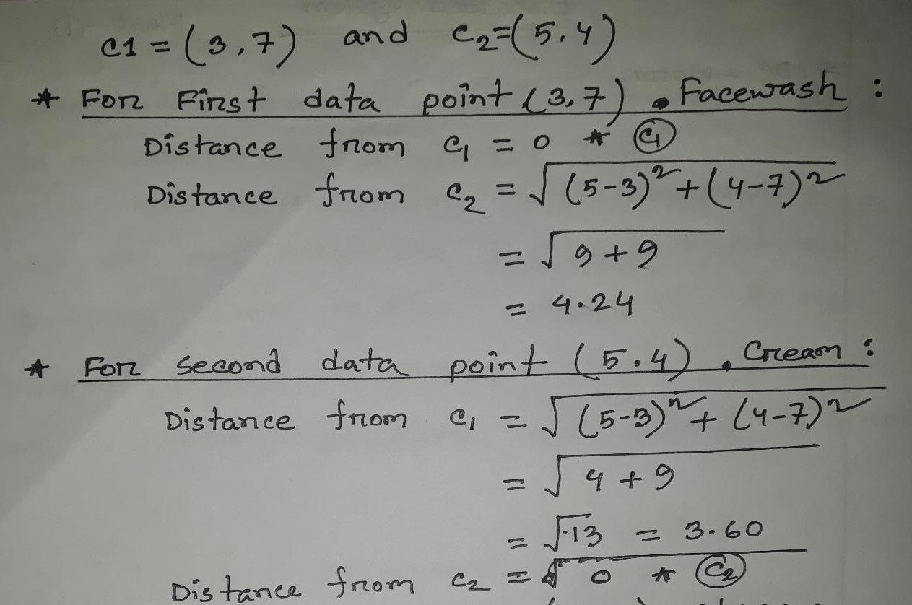

Slide 11
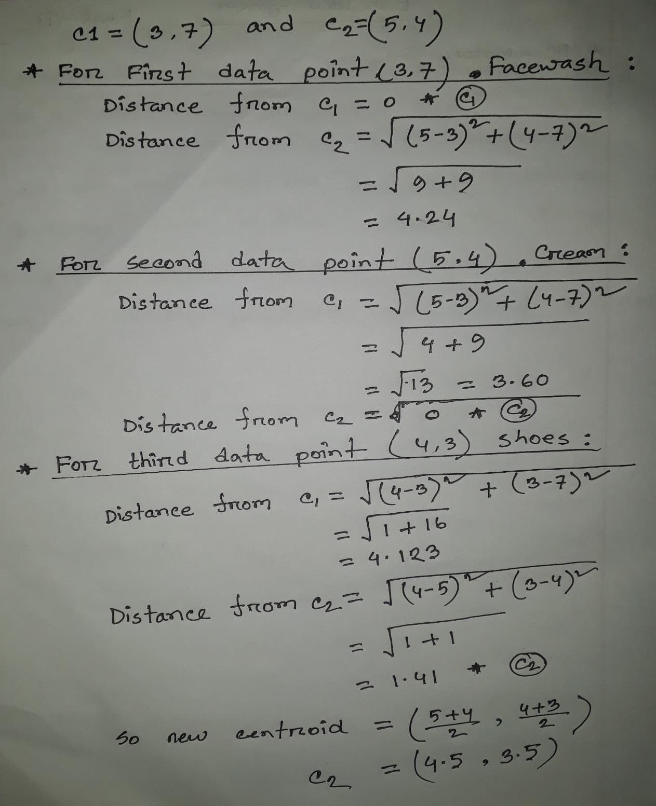

aiQuest

Slide 12
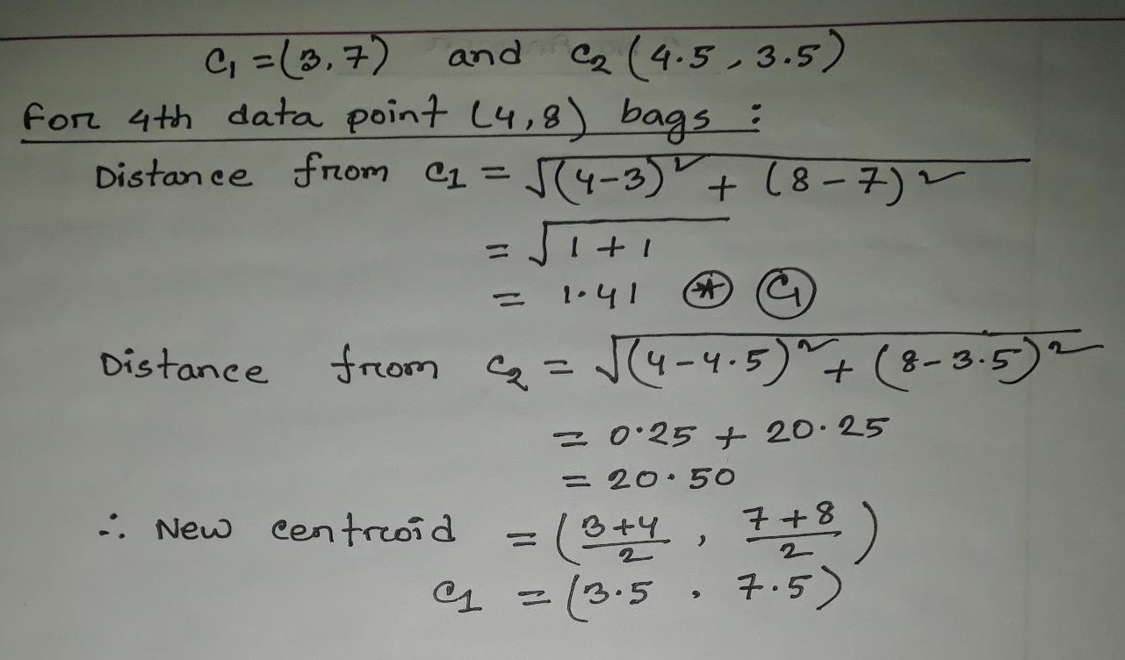
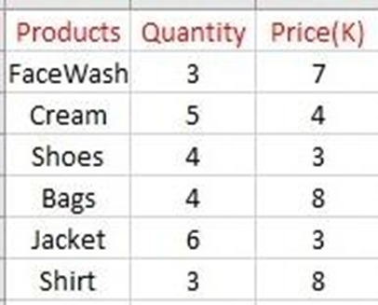

Slide 13
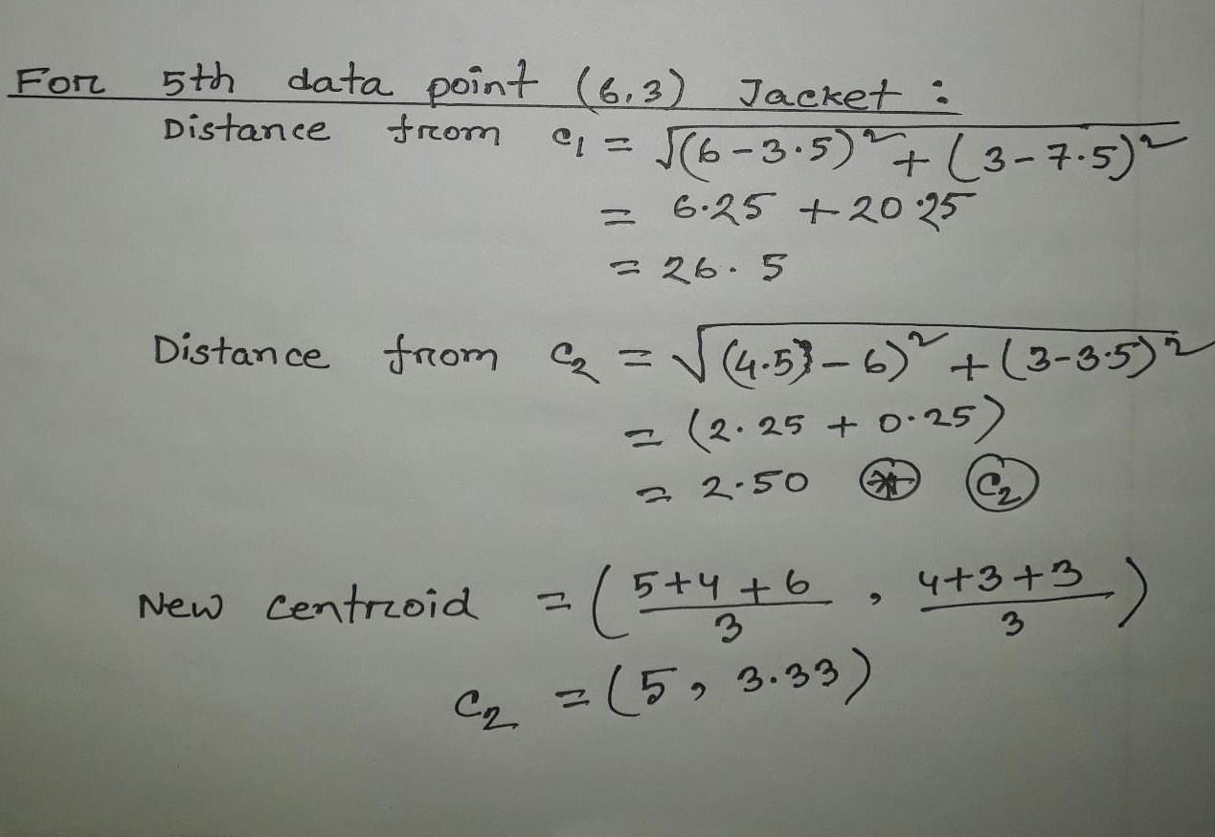

Slide 14
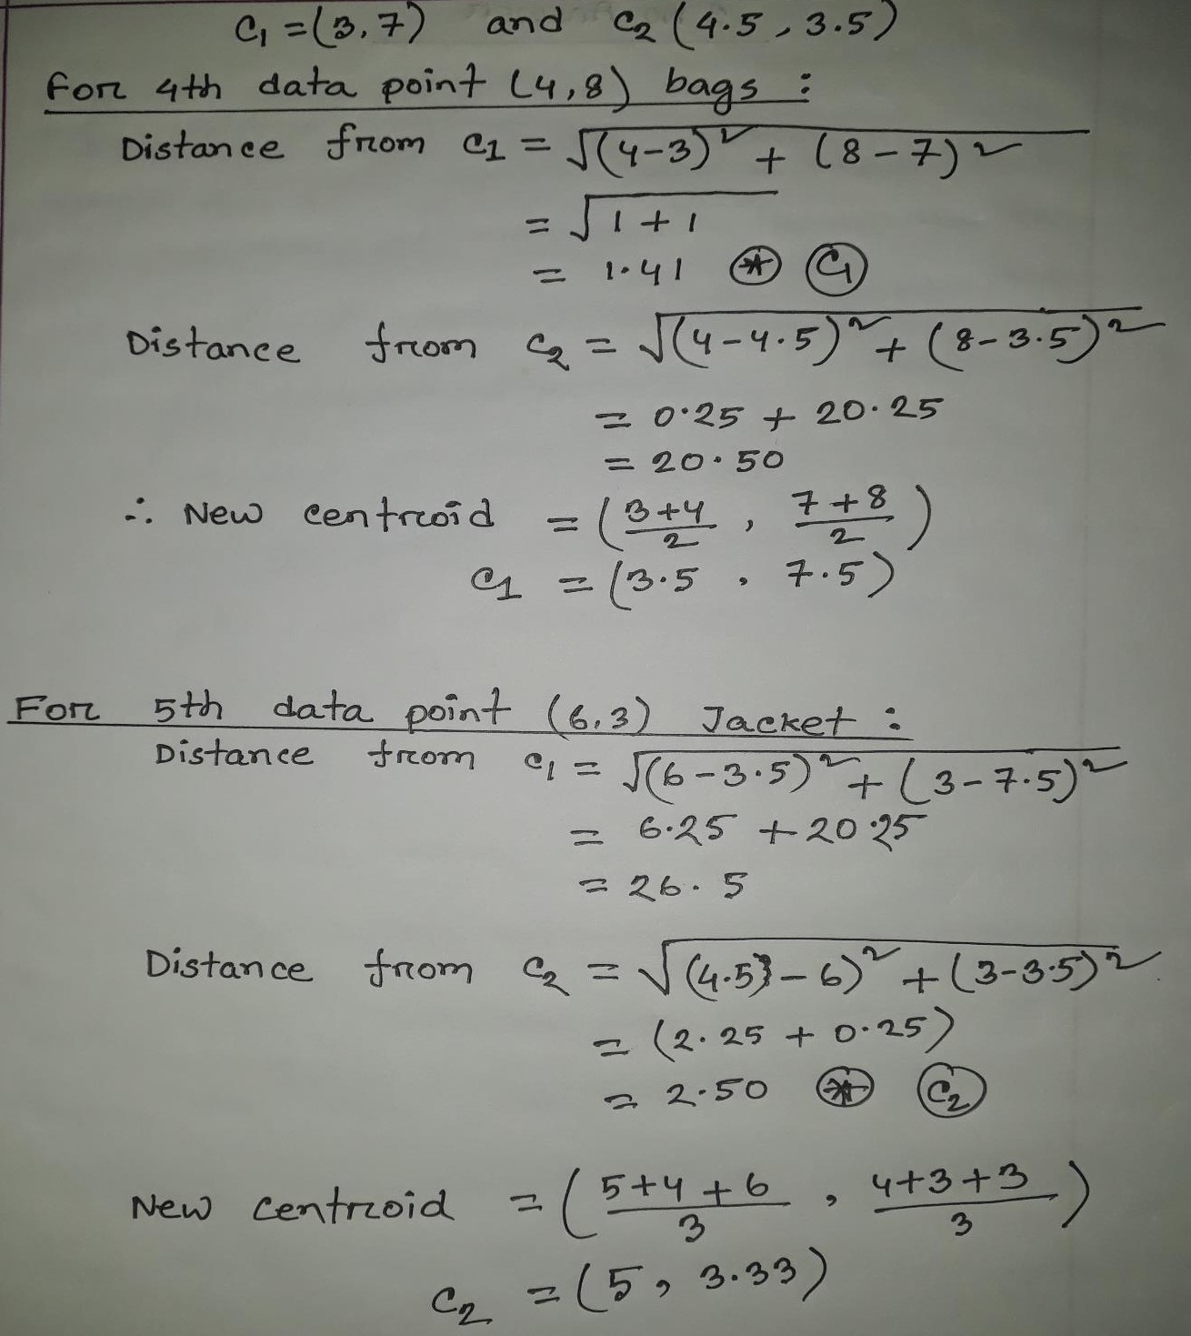

Slide 15
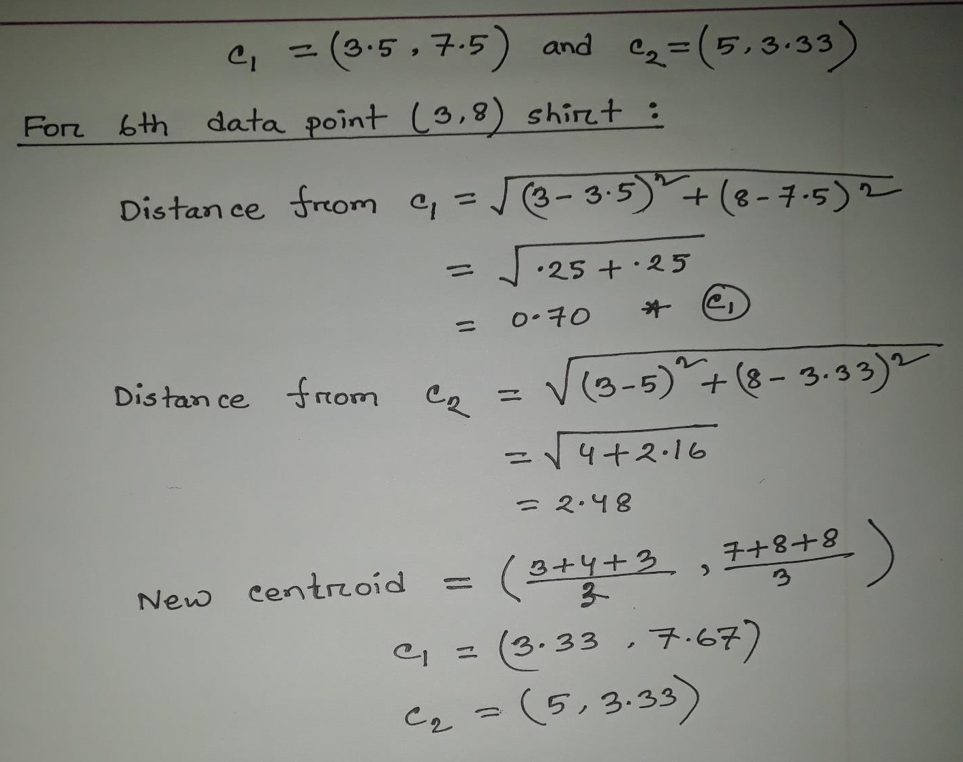

Slide 16
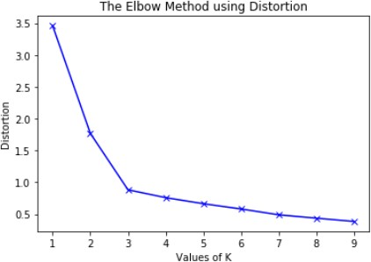
Elbow Method for optimal value of k in KMeans

